Slide 1
Predicting the Existence of Dyslexia in Children Using fMRI
Presented by: Chen Cohen and Tom Beer
Supervised by: Yochai Blau
Clinical expert: Tzipi Horowitz-Kraus
Signal and Image Processing Lab
November 2016

Slide 2
Outline
Motivation & Agenda
Functional MRI
fMRI Data
Current Analysis
Dimensionality Reduction
Non-linear Algorithms - Brief explanation
Results
Clustering
K means
Results
10 Slices
Full Brain analysis
Group Analysis
Alignment check
Results

Slide 3
Outline
Motivation & Agenda
Functional MRI
Current Analysis
Dimensionality Reduction
Clustering
Group Analysis

Slide 4
Motivation & Agenda
Project motivation – why detect Dyslexia using fMRI?
Current diagnosis lacks objective criteria.
Reading disorder is common to many psychiatric and neurological conditions, among them Dyslexia and ADHD. Accurate diagnosis is crucial for proper treatment.
fMRI provides accurate and consistent results for brain function, and has the potential to discriminate between reading disorders.
Project goal:
Find active brain networks using non-linear algorithms in different patient groups, as a basis for identifying differences in brain connectivity.
Motivation & Agenda
Functional MRI
Current Analysis
Dimensionality Reduction
Clustering
Group Analysis
Notes:
Currently, the diagnosis of dyslexia lacks objective criteria, which can decrease treatment efficacy. Diagnosis relies on a discrepancy between reading ability and intelligence, a measure which can be unreliable/ The current diagnosis for dyslexia focuses on lower accuracy and slower reading pace as compared to the expected level for the age, education, and intellectual abilities of the individual according to standardized norms. This definition relies on a discrepancy between intelligence and reading ability in individuals with dyslexia, even though the discrepancy model has been criticized for its poor validity. To date, there is still an ongoing controversy and variability in the definition of dyslexia, which has led to significant diversity in the presentation and diagnosis of this disorder. Furthermore, the multifaceted mechanisms involved in reading deficits challenge clinicians and researchers to provide accurate diagnoses for individuals with reading difficulty.

Slide 5
Next
Motivation & Agenda
Functional MRI
fMRI Data
Current Analysis
Dimensionality Reduction
Clustering
Group Analysis

Slide 6
Functional MRI
fMRI is a neuroimaging technique used to map active brain areas responsible for performed tasks (such as thought, speech, movement, and sensation).
By measuring blood oxygen level dependent (BOLD) signal changes, fMRI detects active regions of the brain.
Increasing attention has been paid to how different parts of the brain connect, interact and coordinate with each other to perform a certain kind of cognitive function.
Motivation & Agenda
Functional MRI
Current Analysis
Dimensionality Reduction
Clustering
Group Analysis
Notes:
Functional connectivity is defined as the temporal dependency of neuronal activation patterns of anatomically separated brain regions and in the past years an increasing body of neuroimaging studies has started to explore functional connectivity by measuring the level of co-activation of resting-state fMRI time-series between brain regions.

Slide 7
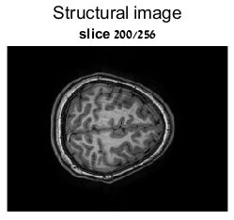
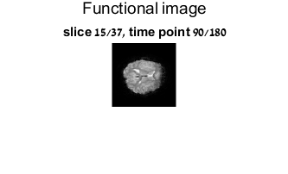
fMRI Data
Every study contains the structural images (256 slices of 192x256 images) and the functional information (37 slices of 64x64 images, practically 150K voxels, over 180 time points).
For example:
Motivation & Agenda
Functional MRI
Current Analysis
Dimensionality Reduction
Clustering
Group Analysis

Slide 8
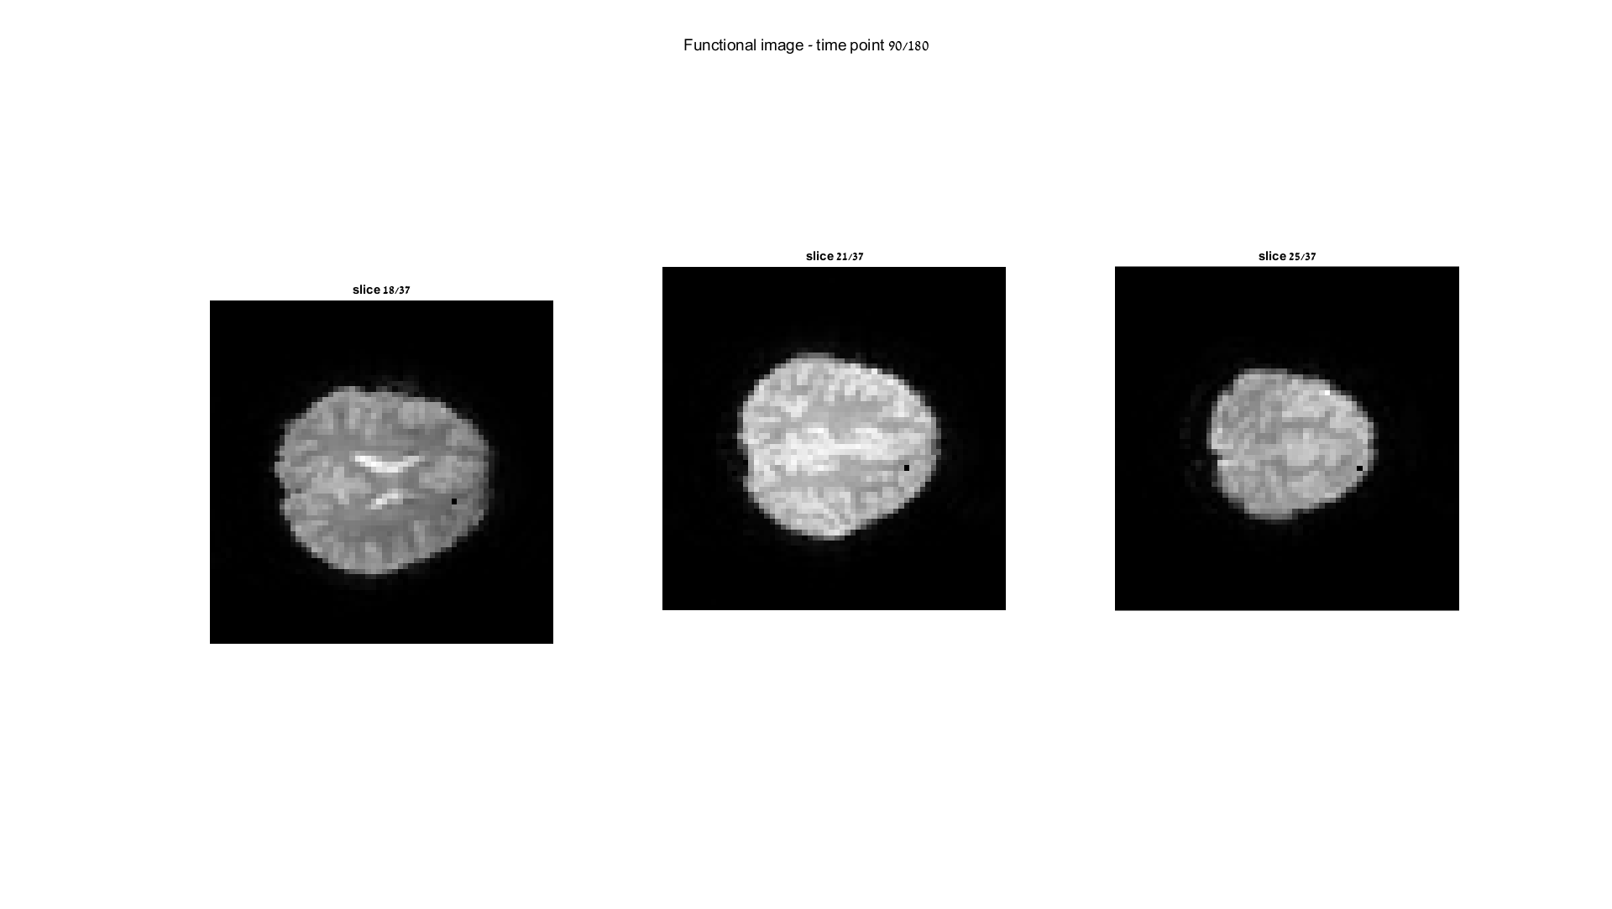
fMRI Data
Let’s take 3 different voxels in the functional image and present their temporal modulation – for example:
Pixel (38,46) in slices 18, 21 and 25:
Motivation & Agenda
Functional MRI
Current Analysis
Dimensionality Reduction
Clustering
Group Analysis

Slide 9
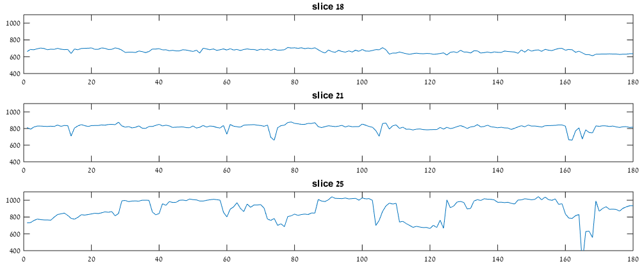
fMRI Data
The temporal modulation over 180 samples:
When we calculate the correlation we get that the pixels in slices 18 and 25 are un-correlated (0.06) while the pixel in slice 21 has significant correlation with both (~0.4).
Motivation & Agenda
Functional MRI
Current Analysis
Dimensionality Reduction
Clustering
Group Analysis

Slide 10
fMRI Data
Now, let’s look at a specific slice and explore the correlation between it’s pixels over time:
Slice 18
Slice 27
Motivation & Agenda
Functional MRI
Current Analysis
Dimensionality Reduction
Clustering
Group Analysis

Slide 11
Next
Motivation & Agenda
Functional MRI
fMRI Data
Current Analysis
Dimensionality Reduction
Clustering
Group Analysis

Slide 12
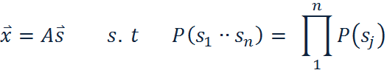
Independent Component Analysis
Assume that the signals are a linear combination of independent components:
ICA finds the independent components and the mixing matrix A
This is done by maximizing independence measures (kurtosis, negentropy, etc.)
Many algorithms exist, the popular is FastICA
ICA is the leading tool to analyze functional brain activity
[van den Hauvel et al., 2010]
Motivation & Agenda
Functional MRI
Current Analysis
Dimensionality Reduction
Clustering
Group Analysis
Notes:
a statistical technique whose aim is to recover hidden underlying source signals from an observed mixture of these sources.

Slide 13
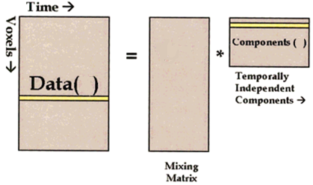
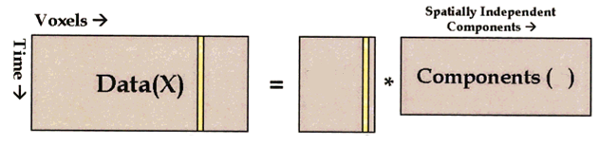
ICA of fMRI data – Spatial vs. Temporal
In our case, the independent components are brain networks (visual, auditory, default mode, etc.)
Two ways to organize the data lead to two distinct approaches: spatial ICA and temporal ICA
180
Temporal
S
A
150K
X
Spatial
150K
180
A
S
Motivation & Agenda
Functional MRI
Current Analysis
Dimensionality Reduction
Clustering
Group Analysis
Notes:
נקודה 2: להסביר שאחד נותן רכיבים ב"ת בזמן, ואחד במקום
לדעת להסביר את הדיאגרמות (להסביר שבאחד מחפשים temporal Ics ובשני spatial Ics)

Slide 14
ICA of fMRI data – Spatial vs. Temporal
sICA and tICA may produce similar results in some instances, and diverging results in others. In any case, neither of them is a priori superior over the other [Calhoun et al., 2001].
Due to the much higher number of voxels than time points in a typical fMRI scan, tICA is more computationally demanding and can easily lose practical feasibility.
Remedies could be found to overcome this obstacle (e.g. sparsification).
Motivation & Agenda
Functional MRI
Current Analysis
Dimensionality Reduction
Clustering
Group Analysis
Notes:
- נקודה 1: ולכן אולי חשוב להסתכל ולחקור את שניהם
http://ieeexplore.ieee.org.ezlibrary.technion.ac.il/stamp/stamp.jsp?tp=&arnumber=6098493
http://research.ics.aalto.fi/events/ica2000/proceedings/0543.pdf
https://arxiv.org/pdf/1012.0269.pdf
http://onlinelibrary.wiley.com.ezlibrary.technion.ac.il/doi/10.1002/hbm.1024/epdf

Slide 15
Baseline
Processing workflow, based on Tzipi’s research:
SPM
Motion Correction
Registration to Standard
GIFT
PCA – dimension reduction
GIFT
Matlab
Single-subject post processing
Temporal Concatenation Group ICA
GIFT
Backprojection
Motivation & Agenda
Functional MRI
Current Analysis
Dimensionality Reduction
Clustering
Group Analysis

Slide 16
Baseline
IC 1
IC 17
Motivation & Agenda
Functional MRI
Current Analysis
Dimensionality Reduction
Clustering
Group Analysis
Notes:
Yochai: Remember you were asked about these timelines, please understand how they are obtained before the presentation

Slide 17
Next
Motivation & Agenda
Functional MRI
fMRI Data
Current Analysis
Dimensionality Reduction
Non-linear Algorithms - Brief explanation
Results
Clustering
Group Analysis

Slide 18
Non-linear Algorithms
Linear algorithms are based on the assumption of linear data mixing. Contrary to the extensive use of linear algorithms like ICA and PCA in the processing of fMRI data, this assumption may not be accurate for brain activity. Studies have observed nonlinearity in resting state fMRI BOLD signals.
For this reason we turned to test nonlinear dimensionality reduction techniques as an alternative to conventional linear clustering algorithms.
Motivation & Agenda
Functional MRI
Current Analysis
Dimensionality Reduction
Clustering
Group Analysis

Slide 19
Non-linear Algorithms
The tested algorithms are the following:
LEM laplacian eigen maps
DM diffusion maps
LLE locally linear embedding
HLLE Hessian LLE
KPCA kernel PCA
LTSA local tangent space alignment
10 Slices analysis
Full brain analysis
10 Slices analysis
Motivation & Agenda
Functional MRI
Current Analysis
Dimensionality Reduction
Clustering
Group Analysis

Slide 20
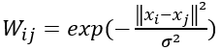
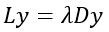
Laplacian Eigenmaps
A manifold learning technique that preserves locality in the embedding from high to low dimensional space.
It emphasizes the natural clusters in the data and so it can be helpful for clustering, and indeed it has a strong relation to spectral clustering.
The algorithm:
Construct a distance graph
Apply weights
Compute and
Solve the generalized eigenvector problem
Motivation & Agenda
Functional MRI
Current Analysis
Dimensionality Reduction
Clustering
Group Analysis
Notes:
Talk about algorithm parameters? Sigma, numDims and k .

Slide 21
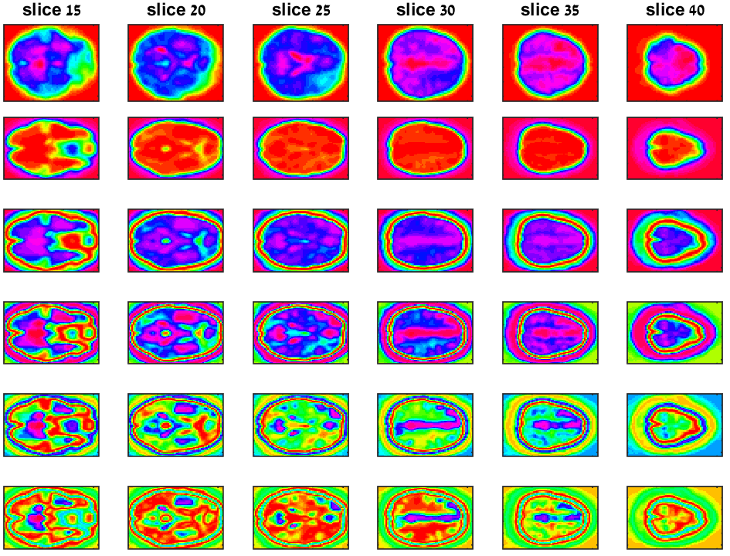
Dimensionality Reduction - Results
Original
Dim #1
Dim #2
Typical – single patient
Dim #3
Dim #4
Dim #5
Motivation & Agenda
Functional MRI
Current Analysis
Dimensionality Reduction
Clustering
Group Analysis

Slide 22
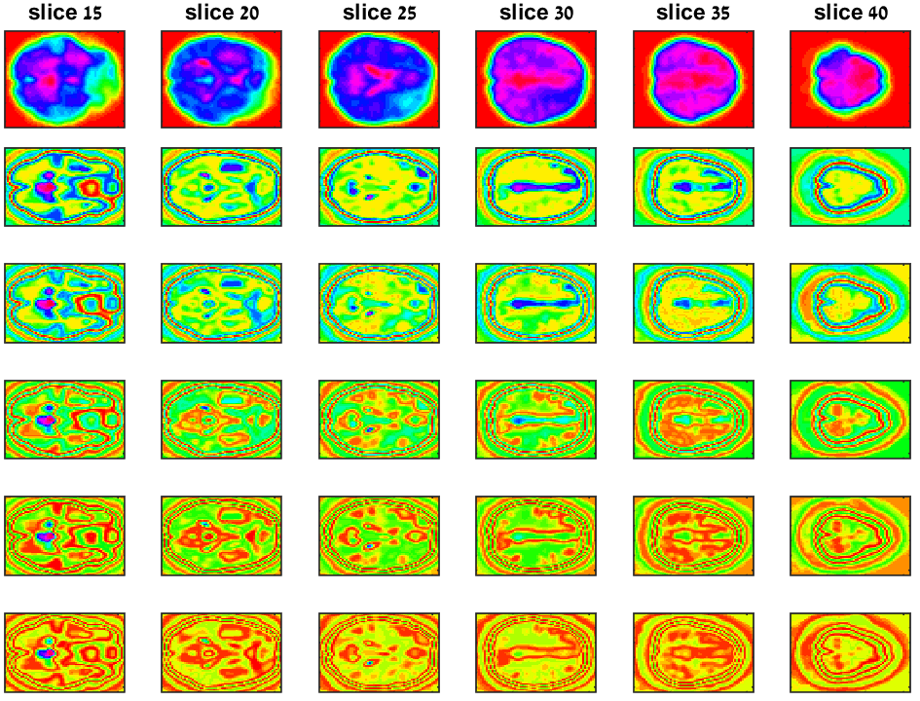
Dimensionality Reduction - Results
Original
Dim #6
Dim #7
Typical – single patient
Dim #8
Dim #9
Dim #10
Motivation & Agenda
Functional MRI
Current Analysis
Dimensionality Reduction
Clustering
Group Analysis

Slide 23
Next
Motivation & Agenda
Functional MRI
fMRI Data
Current Analysis
Dimensionality Reduction
Non-linear Algorithms - Brief explanation
Results
Clustering
K means
Results
10 Slices
Full Brain analysis
Group Analysis

Slide 24
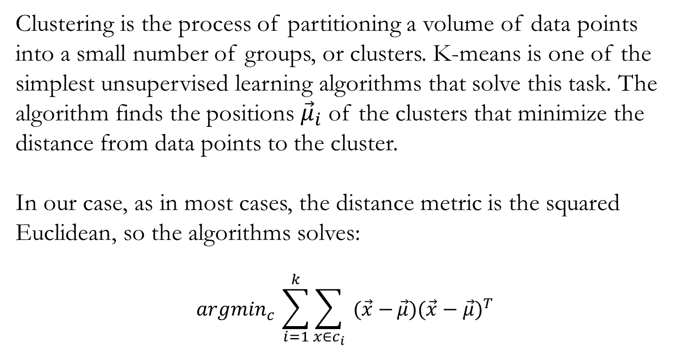
Clustering – K means
Clustering is the process of partitioning a volume of data points into a small number of groups, or clusters. K-means is one of the simplest unsupervised learning algorithms that solve this task. The algorithm finds the positions ${\vec{μ}}_{i}$ of the clusters that minimize the distance from data points to the cluster.
In our case, as in most cases, the distance metric is the squared Euclidean, so the algorithms solves:
$${argmin}_{c }\sum_{i=1}^{k}{\sum_{x∈c_{i}}{ (\vec{x}−}}\vec{μ}){(\vec{x}−\vec{μ})}^{T}$$
Motivation & Agenda
Functional MRI
Current Analysis
Dimensionality Reduction
Clustering
Group Analysis

Slide 25
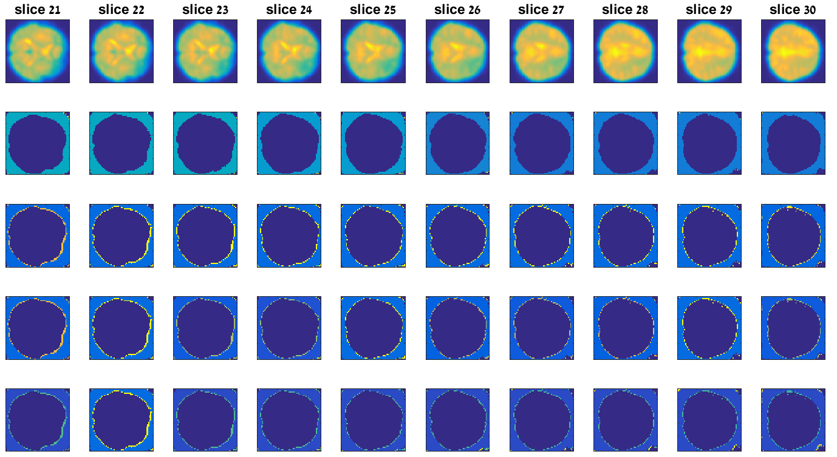

Clustering – 10 Slices Results
LLE
Original
10 Clusters
15 Clusters
20 Clusters
25 Clusters
Motivation & Agenda
Functional MRI
Current Analysis
Dimensionality Reduction
Clustering
Group Analysis

Slide 26
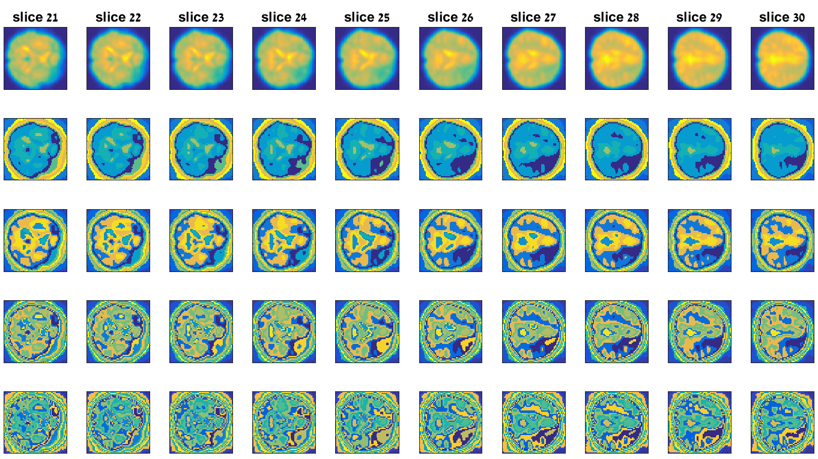
Clustering – 10 Slices Results
LEM
Original
10 Clusters
15 Clusters
20 Clusters
25 Clusters
Motivation & Agenda
Functional MRI
Current Analysis
Dimensionality Reduction
Clustering
Group Analysis

Slide 27
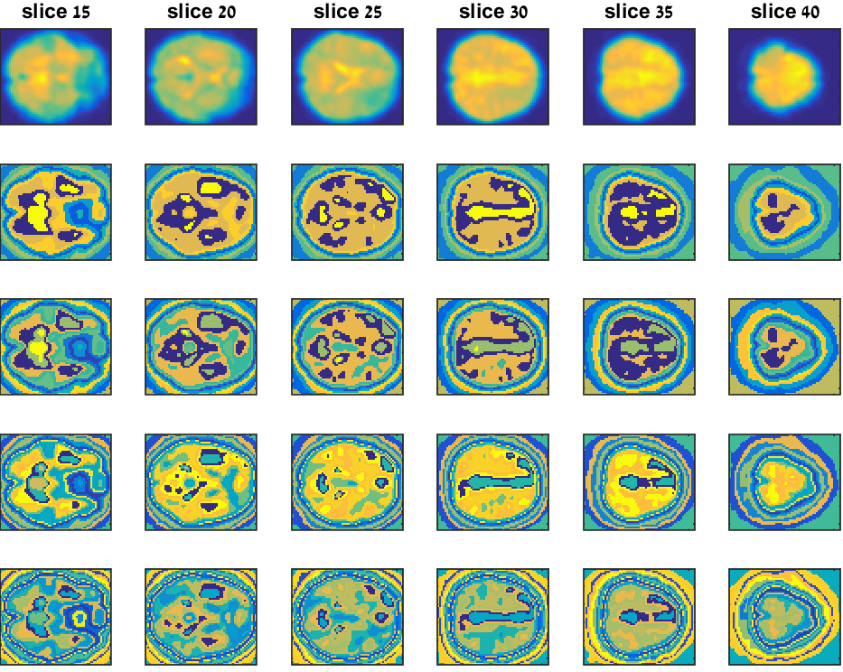
Clustering – Full Brain Results
Original
10 Clusters
15 Clusters
20 Clusters
25 Clusters
Motivation & Agenda
Functional MRI
Current Analysis
Dimensionality Reduction
Clustering
Group Analysis

Slide 28
Next
Motivation & Agenda
Functional MRI
fMRI Data
Current Analysis
Dimensionality Reduction
Non-linear Algorithms - Brief explanation
Results
Clustering
K means
Results
10 Slices
Full Brain analysis
Group Analysis
Alignment check
Results

Slide 29
Group Analysis
Group analysis and inference is used in many fields when comparing studies that can be classified to specific groups.
It has the potential to yield favored results in terms of robustness to noise and outliers, and at many times the produced results capture and characterize the overall behavior of the group.
In this project, we extended the discussed methodologies to a group level analysis, by two distinct approaches.
Motivation & Agenda
Functional MRI
Current Analysis
Dimensionality Reduction
Clustering
Group Analysis

Slide 30
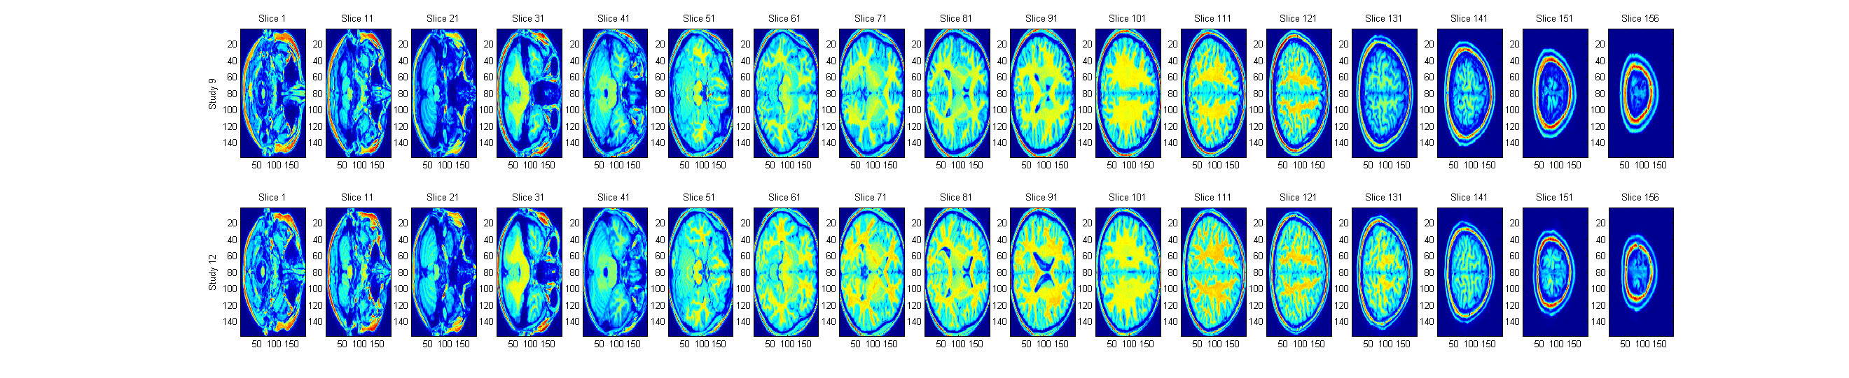
Alignment Check –Anatomical
Study 9
Slice 1
Slice 11
Slice 21
Slice 31
Slice 41
Slice 51
Slice 61
Slice 71
Slice 81
Study 12
Slice 1
Slice 11
Slice 21
Slice 31
Slice 41
Slice 51
Slice 61
Slice 71
Slice 81
Motivation & Agenda
Functional MRI
Current Analysis
Dimensionality Reduction
Clustering
Group Analysis

Slide 31
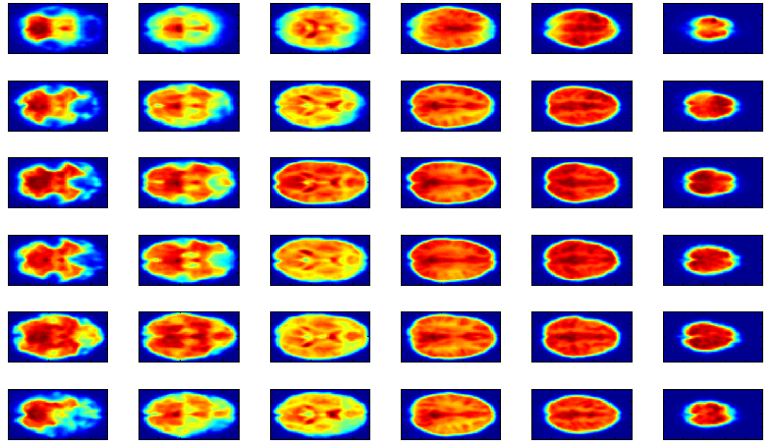
Alignment Check – Functional (Temporal mean)
Slice 25
Slice 30
Slice 40
Slice 50
Slice 60
Slice 70
Study 11
Study 12
Study 16
Study 17
Study 18
Study 24
Motivation & Agenda
Functional MRI
Current Analysis
Dimensionality Reduction
Clustering
Group Analysis

Slide 32
Group Analysis
Temporal Concatenation
180
180
180
180
79
95
X 180
reshape
Dimensionality
Reduction using
Laplacian Eigenmaps
79
Temporal concat. 20 studies
……
~600K
fMRI data
180x20
* The analysis was performed only for slices 25-70 (out of total 79 slices)
Motivation & Agenda
Functional MRI
Current Analysis
Dimensionality Reduction
Clustering
Group Analysis

Slide 33
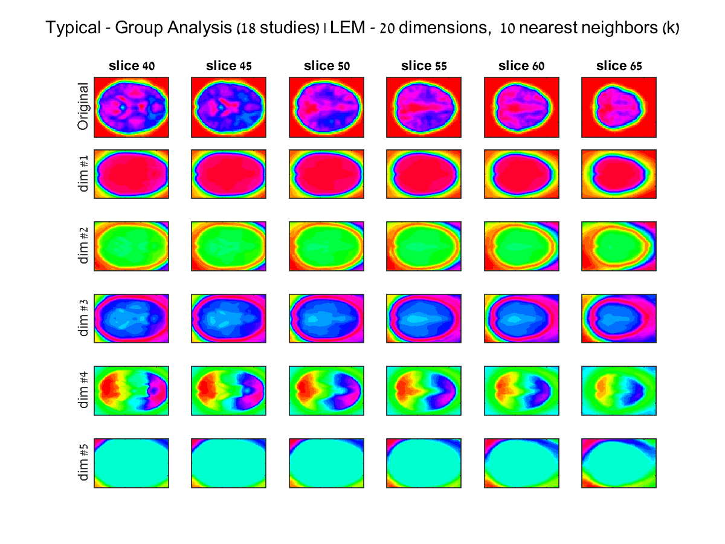
Temporal Concatenation - Results
Slice 40 Slice 45 Slice 50 Slice 55 Slice 60 Slice 65
Dim #1
Dim #2
Typical Group
Dim #3
Dim #4
Dim #5
Motivation & Agenda
Functional MRI
Current Analysis
Dimensionality Reduction
Clustering
Group Analysis

Slide 34
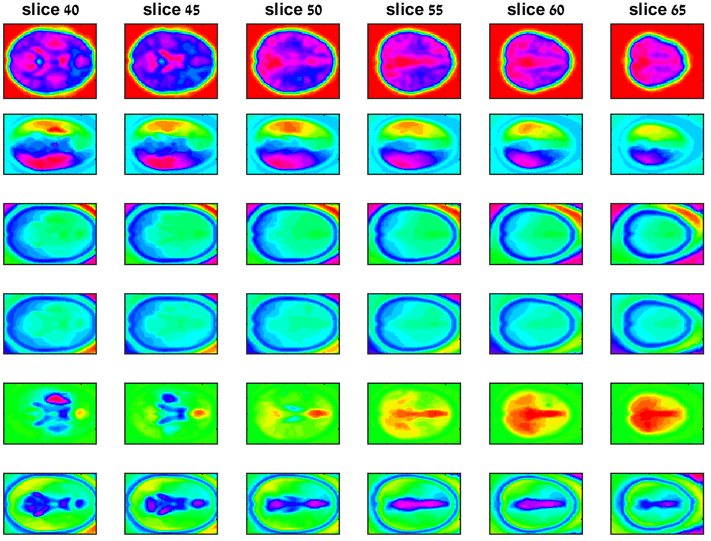
Temporal Concatenation - Results
Dim #6
Dim #7
Typical Group
Dim #8
Dim #9
Dim #10
Motivation & Agenda
Functional MRI
Current Analysis
Dimensionality Reduction
Clustering
Group Analysis

Slide 35
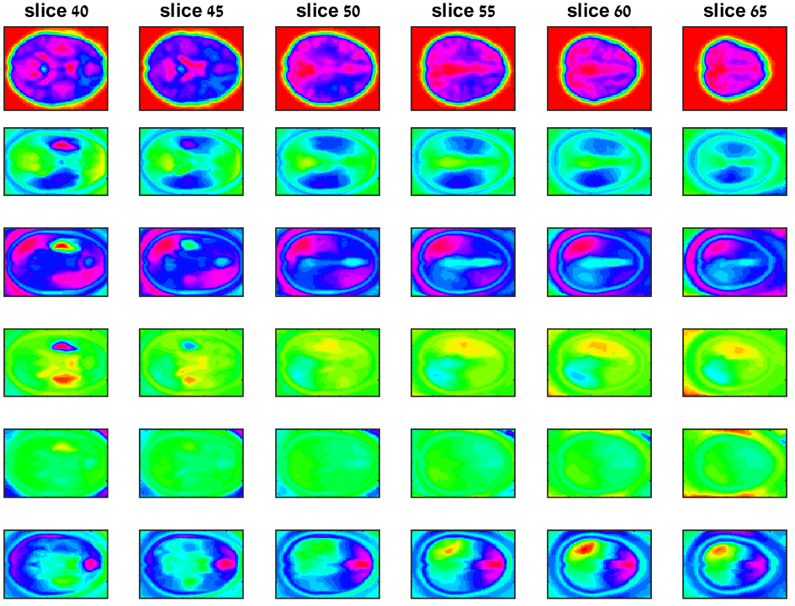
Temporal Concatenation - Results
Dim #11
Dim #12
Typical Group
Dim #13
Dim #14
Dim #15
Motivation & Agenda
Functional MRI
Current Analysis
Dimensionality Reduction
Clustering
Group Analysis

Slide 36
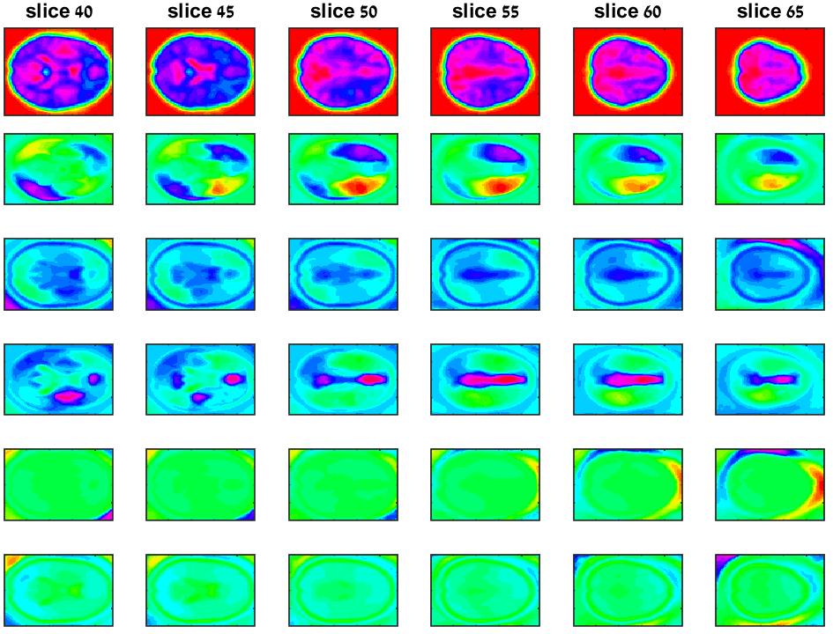
Temporal Concatenation - Results
Dim #16
Dim #17
Typical Group
Dim #18
Dim #19
Dim #20
Motivation & Agenda
Functional MRI
Current Analysis
Dimensionality Reduction
Clustering
Group Analysis

Slide 37
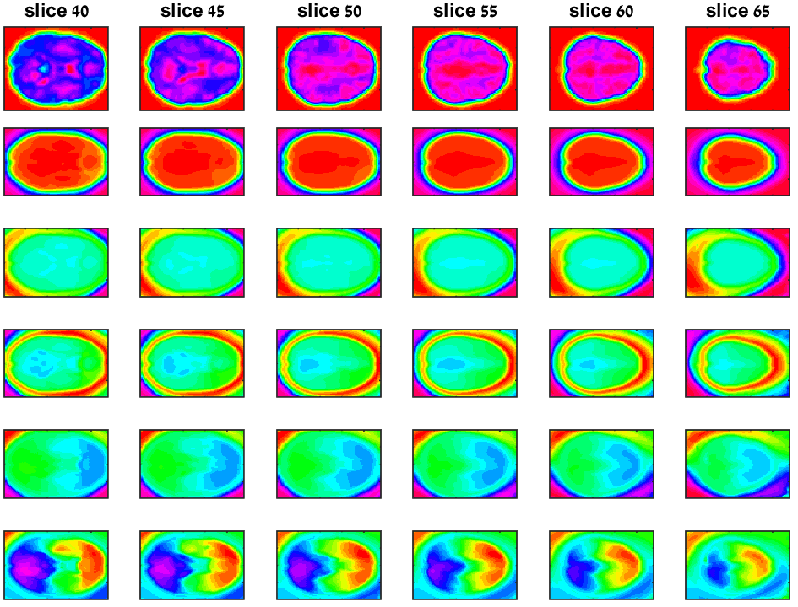
Temporal Concatenation - Results
Dim #1
Dim #2
Dyslexics Group
Dim #3
Dim #4
Dim #5
Motivation & Agenda
Functional MRI
Current Analysis
Dimensionality Reduction
Clustering
Group Analysis

Slide 38
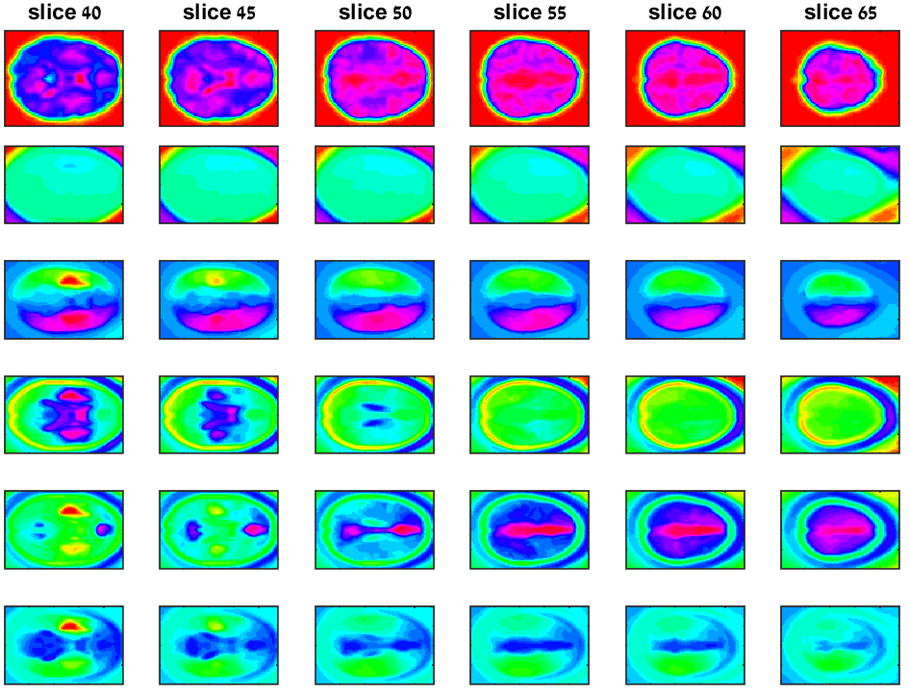
Temporal Concatenation - Results
Dim #6
Dim #7
Dyslexics Group
Dim #8
Dim #9
Dim #10
Motivation & Agenda
Functional MRI
Current Analysis
Dimensionality Reduction
Clustering
Group Analysis

Slide 39
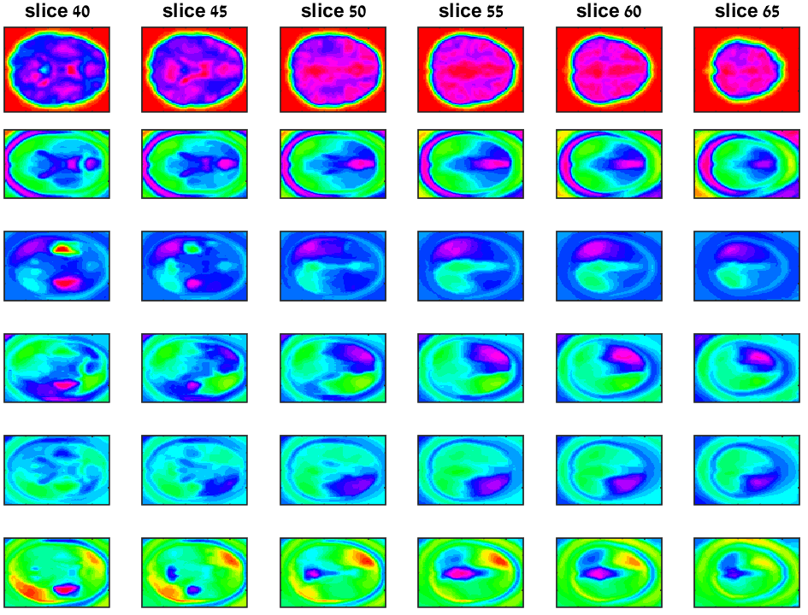
Temporal Concatenation - Results
Dim #11
Dim #12
Dyslexics Group
Dim #13
Dim #14
Dim #15
Motivation & Agenda
Functional MRI
Current Analysis
Dimensionality Reduction
Clustering
Group Analysis

Slide 40
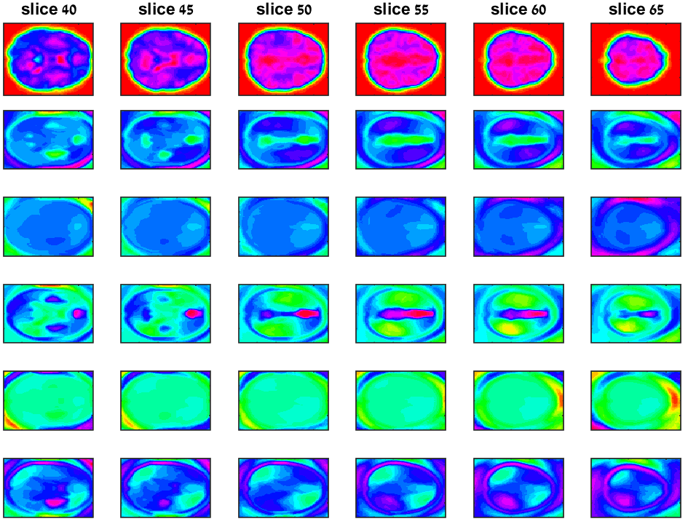
Temporal Concatenation - Results
Dim #16
Dim #17
Dyslexics Group
Dim #18
Dim #19
Dim #20
Motivation & Agenda
Functional MRI
Current Analysis
Dimensionality Reduction
Clustering
Group Analysis

Slide 41
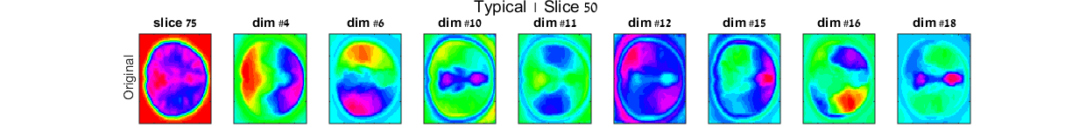
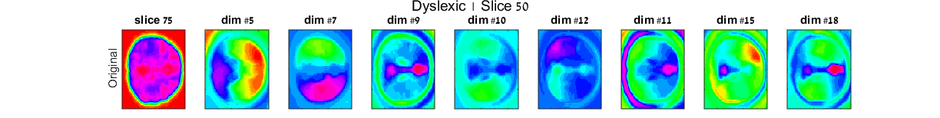
Temporal Concatenation Inter-group Comparison
Typical
Dyslexics
Motivation & Agenda
Functional MRI
Current Analysis
Dimensionality Reduction
Clustering
Group Analysis

Slide 42
Group Analysis
2. Average Weight Matrix
180
For each of the 20 studies
Calculating average G
79
reshape
95
Calculating weight matrix G
X 180
79
~600K
Complete dimensionality reduction using Laplacian Eigenmaps
fMRI data
* The analysis was performed only for slices 25-70 (out of total 79 slices)
Motivation & Agenda
Functional MRI
Current Analysis
Dimensionality Reduction
Clustering
Group Analysis

Slide 43
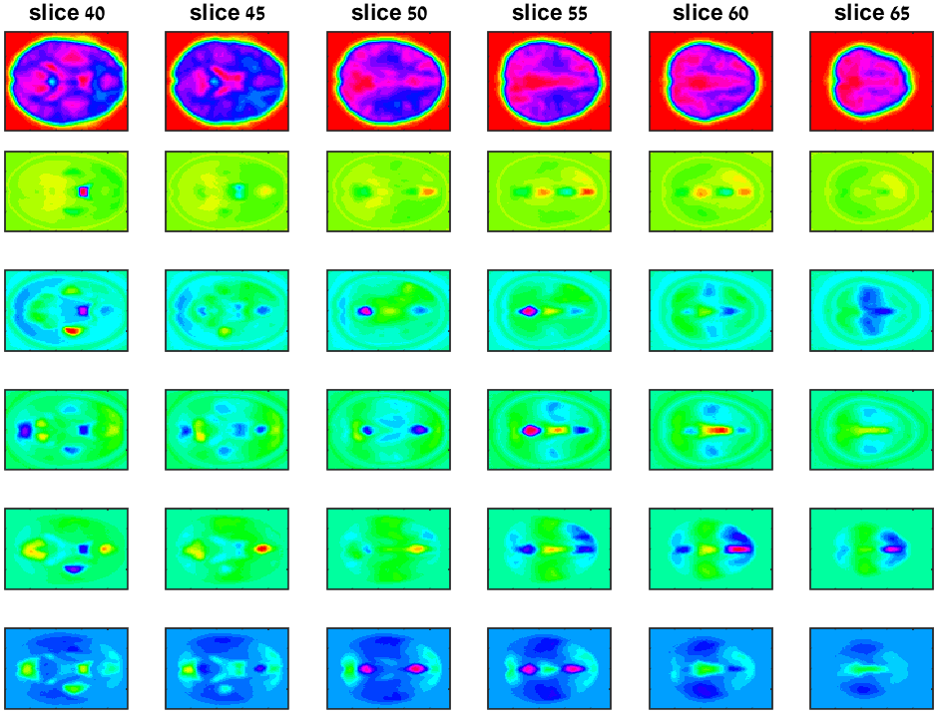
Average Weight Matrix - Results
Dim #1
Dim #2
Typical Group
Dim #3
Dim #4
Dim #5
10 iterations, block size 1000
Motivation & Agenda
Functional MRI
Current Analysis
Dimensionality Reduction
Clustering
Group Analysis

Slide 44
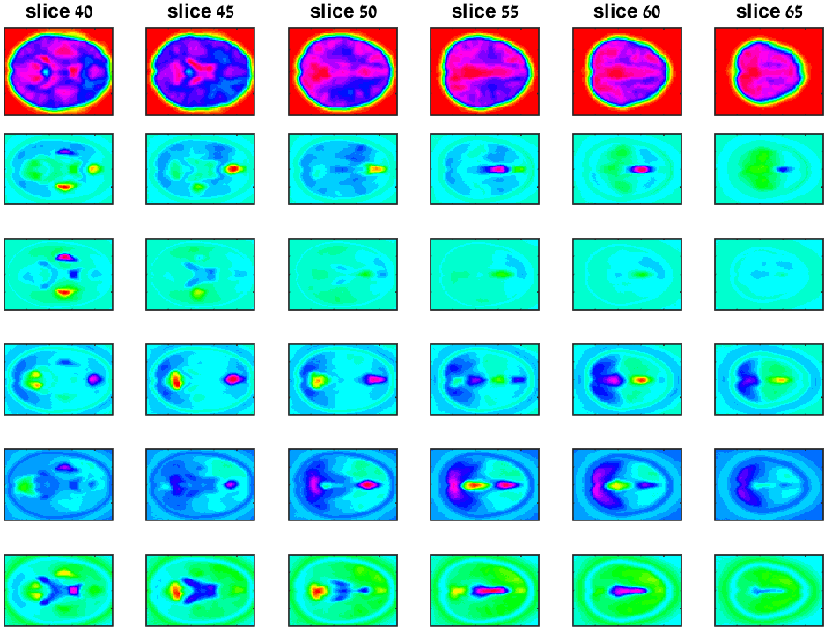
Average Weight Matrix - Results
Dim #6
Dim #7
Typical Group
Dim #8
Dim #9
Dim #10
10 iterations, block size 1000
Motivation & Agenda
Functional MRI
Current Analysis
Dimensionality Reduction
Clustering
Group Analysis

Slide 45
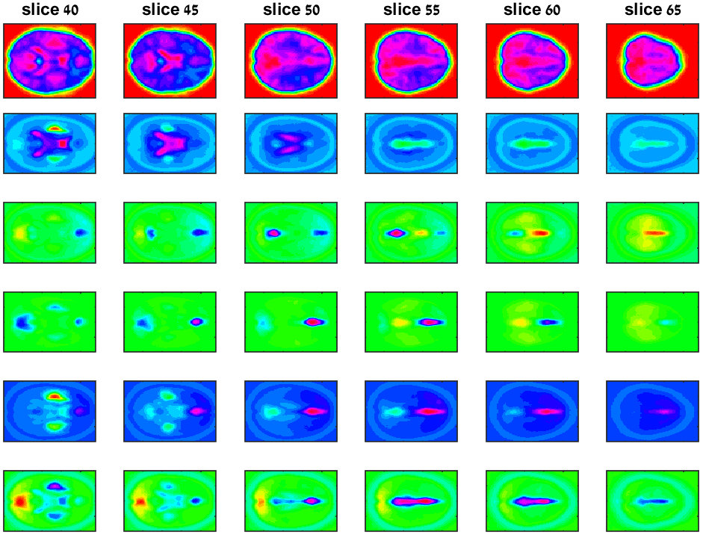
Average Weight Matrix - Results
Dim #11
Dim #12
Typical Group
Dim #13
Dim #14
Dim #15
10 iterations, block size 1000
Motivation & Agenda
Functional MRI
Current Analysis
Dimensionality Reduction
Clustering
Group Analysis

Slide 46
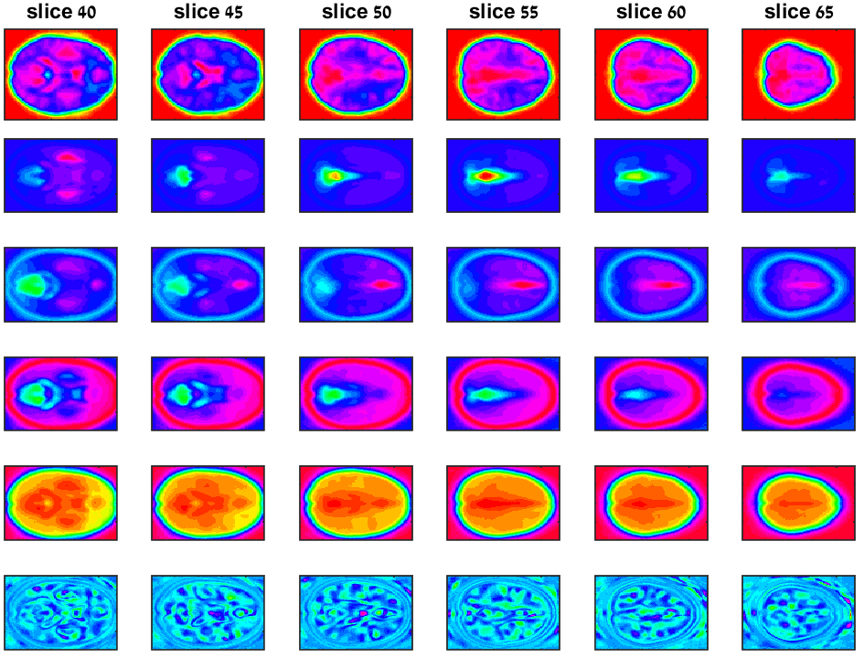
Average Weight Matrix - Results
Dim #16
Dim #17
Typical Group
Dim #18
Dim #19
Dim #20
10 iterations, block size 1000
Motivation & Agenda
Functional MRI
Current Analysis
Dimensionality Reduction
Clustering
Group Analysis

Slide 47
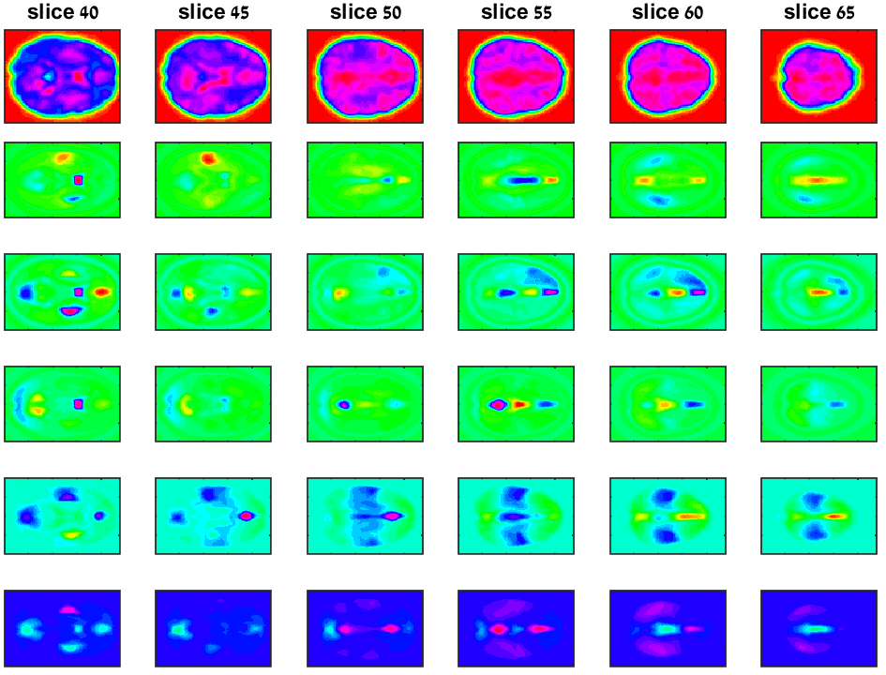
Average Weight Matrix - Results
Dim #1
Dim #2
Dyslexics Group
Dim #3
Dim #4
Dim #5
10 iterations, block size 1000
Motivation & Agenda
Functional MRI
Current Analysis
Dimensionality Reduction
Clustering
Group Analysis

Slide 48
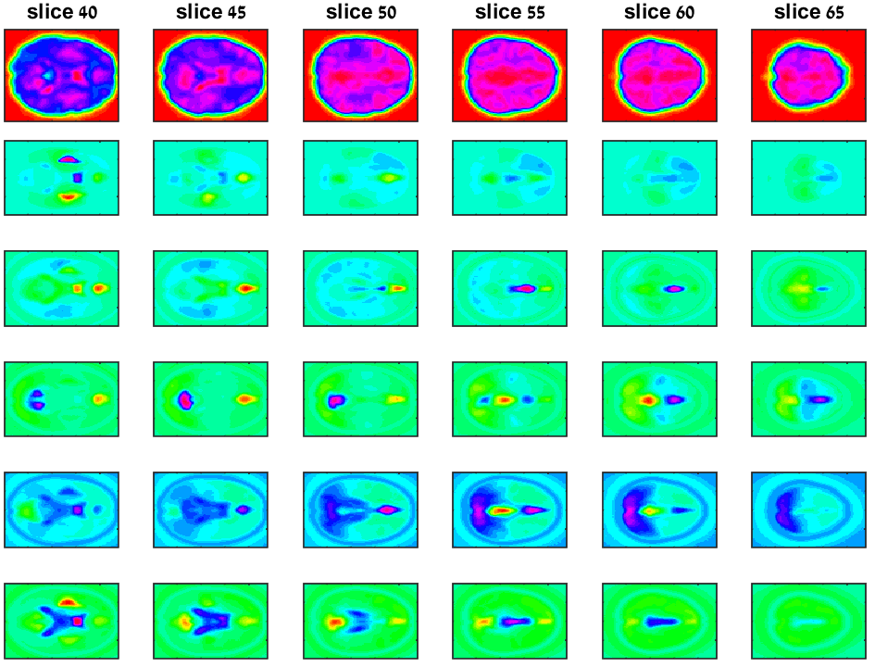
Average Weight Matrix - Results
Dim #6
Dim #7
Dyslexics Group
Dim #8
Dim #9
Dim #10
10 iterations, block size 1000
Motivation & Agenda
Functional MRI
Current Analysis
Dimensionality Reduction
Clustering
Group Analysis

Slide 49
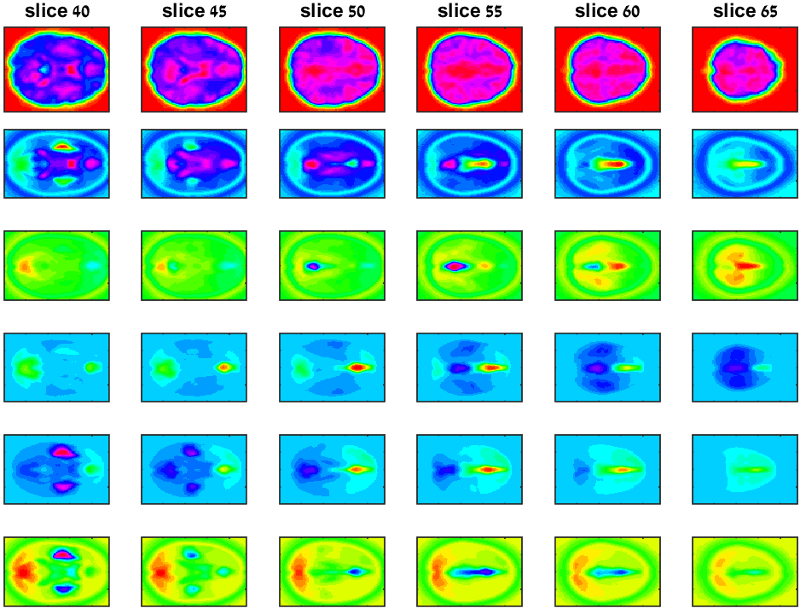
Average Weight Matrix - Results
Dim #11
Dim #12
Dyslexics Group
Dim #13
Dim #14
Dim #15
10 iterations, block size 1000
Motivation & Agenda
Functional MRI
Current Analysis
Dimensionality Reduction
Clustering
Group Analysis

Slide 50
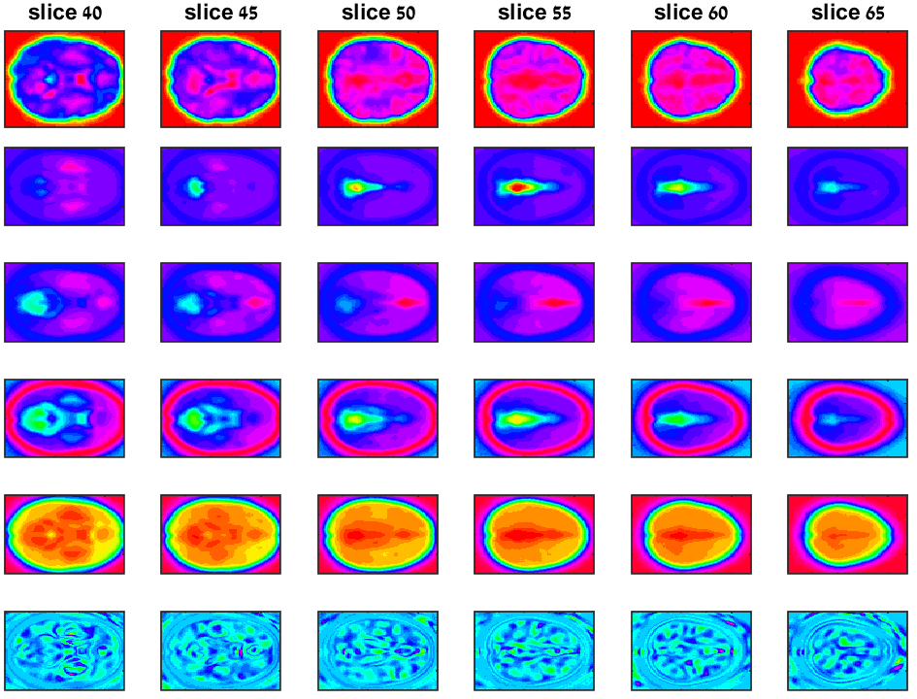
Average Weight Matrix - Results
Dim #16
Dim #17
Dyslexics Group
Dim #18
Dim #19
Dim #20
10 iterations, block size 1000
Motivation & Agenda
Functional MRI
Current Analysis
Dimensionality Reduction
Clustering
Group Analysis

Slide 51
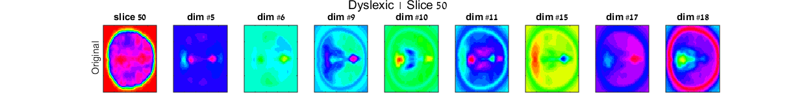
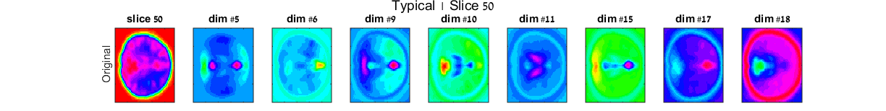
Average Weight Matrix Inter-group Comparison
Typical
Dyslexics
Motivation & Agenda
Functional MRI
Current Analysis
Dimensionality Reduction
Clustering
Group Analysis

Slide 52
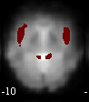
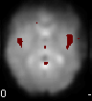
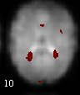
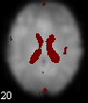
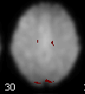
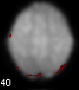
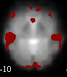
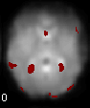
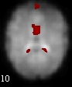
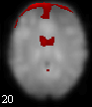
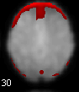
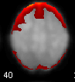
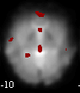

















ICA - GIFT Results
Slice -10
Slice 0
Slice 10
Slice 20
Slice 30
Slice 40
IC#1
IC#2
Typical Group
IC#3
IC#4
IC#5
Motivation & Agenda
Functional MRI
Current Analysis
Dimensionality Reduction
Clustering
Group Analysis

Slide 53






























ICA - GIFT Results
Slice -10
Slice 0
Slice 10
Slice 20
Slice 30
Slice 40
IC#6
IC#7
Typical Group
IC#8
IC#9
IC#10
Motivation & Agenda
Functional MRI
Current Analysis
Dimensionality Reduction
Clustering
Group Analysis

Slide 54
Summary
Motivation & Agenda
Functional MRI
Current Analysis
Dimensionality Reduction
Clustering
Group Analysis
Current diagnosis of dyslexia lacks objective criteria, which can decrease treatment efficacy.
Unique tool that enables widespread, noninvasive investigation of brain functions.
Linear algorithms such as PCA and ICA, assuming data linearity.
SPM preprocessing – motion & time corrections, smoothing, etc.
An alternative to conventional linear clustering algorithms.
Partitioning a volume of data points into a small number of groups, using K-means.
In order to study specific conditions within or between groups of subjects, using two methods.
We focused on LEM.

Slide 55
Thank you

